Slide 1
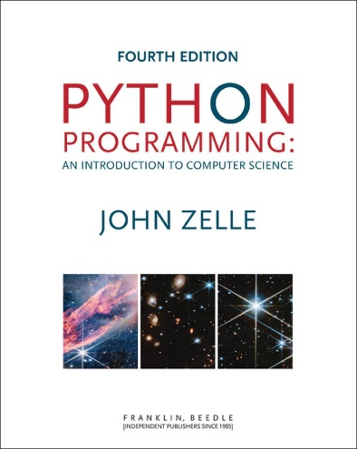
Python Programming: An Introduction to Computer Science
Chapter 4
Objects and Graphics

Slide 2
Objectives
To understand the concept of objects and how they can be used to simplify programming.
To be familiar with the various objects available in the graphics library.
To be able to create objects in programs and call appropriate methods to perform graphical computations.

Slide 3
Objectives
To understand the fundamental concepts of computer graphics, especially the role of coordinate systems.
To understand how to work with both mouse- and text-based input in a graphical programming context.

Slide 4
Objectives
To be able to write simple interactive graphics programs using the graphics library.

Slide 5
Overview
Each data type can represent a certain set of values, and each had a set of associated operations.
The traditional programming view is that data is passive – it’s manipulated and combined with active operations.

Slide 6
Overview
Modern computer programs are built using an object-oriented approach.
Most applications you’re familiar with have Graphical User Interfaces (GUI) that provide windows, icons, buttons and menus.
There’s a graphics library (graphics.py) written specifically to go with this book. It’s based on Tkinter.

Slide 7
The Object of Objects
Basic idea – view a complex system as the interaction of simpler objects. An object is a sort of active data type that combines data and operations.
Objects know stuff (contain data) and they can do stuff (have operations).
Objects interact by sending each other messages.

Slide 8
The Object of Objects
Suppose we want to develop a data processing system for a college or university.
We must keep records on students who attend the school. Each student will be represented as an object.

Slide 9
The Object of Objects
The student object would contain data like:
Name
ID number
Courses taken
Campus Address
Home Address
GPA
Etc.

Slide 10
The Object of Objects
The student object should also respond to requests.
We may want to send out a campus-wide mailing, so we’d need a campus address for each student.
We could send the printCampusAddress to each student object. When the student object receives the message, it prints its own address.

Slide 11
Object of Objects
Objects may refer to other objects.
Each course might be represented by an object:
Instructor
Student roster
Prerequisite courses
When and where the class meets

Slide 12
Object of Objects
Sample Operation
addStudent
delStudent
changeRoom
Etc.

Slide 13
Simple Graphics Programming
This chapter uses the graphics.py library supplied with the supplemental materials.
Two location choices
In Python’s Lib directory with other libraries
In the same folder as your graphics program

Slide 14
Simple Graphics Programming
Since this is a library, we need to import the graphics commands >>> import graphics
A graphics window is a place on the screen where the graphics will appear. >>> win = graphics.GraphWin()
This command creates a new window titled “Graphics Window.”

Slide 15
Simple Graphics Programming

Slide 16
Simple Graphics Programming
GraphWin is an object assigned to the variable win. We can manipulate the window object through this variable.
Windows can be closed/destroyed by issuing the command >>> win.close()

Slide 17
Simple Graphics Programming
It’s tedious to use the graphics. notation to access the graphics library routines.
from graphics import * The “from” statement allows you to load specific functions from a library module. “*” will load all the functions, or you can list specific ones.

Slide 18
Simple Graphics Programming
Doing the import this way eliminates the need to preface graphics commands with graphics. >>> from graphics import * >>> win = GraphWin()

Slide 19
Simple Graphics Programming
A graphics window is a collection of points called pixels (picture elements).
The default GraphWin is 200 pixels tall by 200 pixels wide (40,000 pixels total).
One way to get pictures into the window is one pixel at a time, which would be tedious. The graphics library has a number of predefined routines to draw geometric shapes.
Notes:
Python Programming, 1/e
19

Slide 20
Simple Graphics Programming
The simplest object is the Point. Like points in geometry, point locations are represented with a coordinate system (x, y), where x is the horizontal location of the point and y is the vertical location.
The origin (0,0) in a graphics window is the upper left corner.
X values increase from left to right, y values from top to bottom.
Lower right corner is (199, 199)

Slide 21
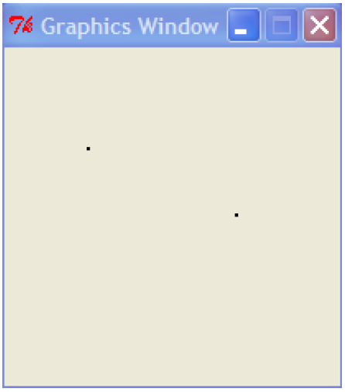
Simple Graphics Programming
>>> p = Point(50, 60)
>>> p.getX()
50
>>> p.getY()
60
>>> win = GraphWin()
>>> p.draw(win)
>>> p2 = Point(140, 100)
>>> p2.draw(win)

Slide 22
Simple Graphics Programming
>>> ### Open a graphics window
>>> win = GraphWin('Shapes')
>>> ### Draw a red circle centered at point
>>> ### (100, 100) with radius 30
>>> center = Point(100, 100)
>>> circ = Circle(center, 30)
>>> circ.setFill('red')
>>> circ.draw(win)
>>> ### Put a textual label in the center of the circle
>>> label = Text(center, "Red Circle")
>>> label.draw(win)
>>> ### Draw a square using a Rectangle object
>>> rect = Rectangle(Point(30, 30), Point(70, 70))
>>> rect.draw(win)
>>> ### Draw a line segment using a Line object
>>> line = Line(Point(20, 30), Point(180, 165))
>>> line.draw(win)
>>> ### Draw an oval using the Oval object
>>> oval = Oval(Point(20, 150), Point(180, 199))
>>> oval.draw(win)

Slide 23
Using Graphical Objects
Computation is performed by asking an object to carry out one of its operations.
In the previous example we manipulated GraphWin, Point, Circle, Oval, Line, Text and Rectangle. These are examples of classes.

Slide 24
Using Graphical Objects
Each object is an instance of some class, and the class describes the properties of the instance.
If we say that Augie is a dog, we are actually saying that Augie is a specific individual in the larger class of all dogs. Augie is an instance of the dog class.

Slide 25
Using Graphical Objects
To create a new instance of a class, we use a special operation called a constructor. <class-name>(<param1>, <param2>, …)
<class-name> is the name of the class we want to create a new instance of, e.g. Circle or Point.
The parameters are required to initialize the object. For example, Point requires two numeric values.

Slide 26
Using Graphical Objects
p = Point(50, 60) The constructor for the Point class requires two parameters, the x and y coordinates for the point.
These values are stored as instance variables inside of the object.

Slide 27
Using Graphical Objects
Only the most relevant instance variables are shown (others include the color, window they belong to, etc.)

Slide 28
Using Graphical Objects
To perform an operation on an object, we send the object a message. The set of messages an object responds to are called the methods of the object.
Methods are like functions that live inside the object.
Methods are invoked using dot-notation: <object>.<method-name>(<param1>, <param2>, …)

Slide 29
Using Graphical Objects
p.getX() and p.getY() return the x and y values of the point. Routines like these are referred to as accessors because they allow us to access information from the instance variables of the object.

Slide 30
Using Graphical Objects
Other methods change the state of the object by changing the values of the object’s instance variables.
move(dx, dy) moves the object dx units in the x direction and dy in the y direction.
Move erases the old image and draws it in its new position. Methods that change the state of an object are called mutators.

Slide 31
Using Graphical Objects
>>> circ = Circle(Point(100, 100), 30) >>> win = GraphWin() >>> circ.draw(win)
The first line creates a circle with radius 30 centered at (100,100).
We used the Point constructor to create a location for the center of the circle.
The last line is a request to the Circle object circ to draw itself into the GraphWin object win.

Slide 32
Using Graphical Objects
The draw method uses information about the center and radius of the circle from the instance variable.

Slide 33
Using Graphical Objects
It’s possible for two different variables to refer to the same object – changes made to the object through one variable will be visible to the other.
>>> leftEye = Circle(Point(80,50), 5) >>> leftEye.setFill('yellow') >>> leftEye.setOutline('red') >>> rightEye = leftEye >>> rightEye.move(20,0)
The idea is to create the left eye and copy that to the right eye which gets moved over 20 units.

Slide 34
Using Graphical Objects
The assignment rightEye = leftEye makes rightEye and leftEye refer to the same circle!
The situation where two variables refer to the same object is called aliasing.

Slide 35
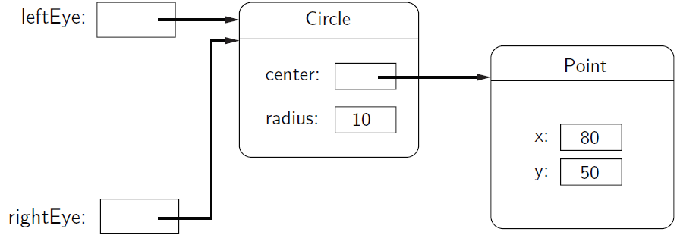
Using Graphical Objects

Slide 36
Using Graphical Objects
There are two ways to get around this.
We could make two separate circles, one for each eye: >>> leftEye = Circle(Point(80, 50), 5) >>> leftEye.setFill('yellow') >>> leftEye.setOutline('red') >>> rightEye = Circle(Point(100, 50), 5) >>> rightEye.setFill('yellow') >>> rightEye.setOutline('red')

Slide 37
Using Graphical Objects
The graphics library has a better solution. Graphical objects have a clone method that will make a copy of the object! >>> # Correct way to create two circles, using clone >>> leftEye = Circle(Point(80, 50), 5) >>> leftEye.setFill('yellow') >>> leftEye.setOutline('red') >>> rightEye = leftEye.clone() >>> # rightEye is an exact copy of the left >>> rightEye.move(20, 0)

Slide 38
Using Graphical Objects
Print an introduction
Get value of principal and apr from user
Create a GraphWin
Draw scale labels on left side of window
Draw bar at position 0 with height corresponding to principal
For successive years 1 through 10
Calculate principal = principal * (1 + apr)
Draw a bar for this year having a height corresponding to principal
Wait for user to press Enter.

Slide 39
Graphing Future Value/ Choosing Coordinates

Slide 40
Interactive Graphics
In a GUI environment, users typically interact with their applications by clicking on buttons, choosing items from menus, and typing information into on-screen text boxes.
Event-driven programming draws interface elements (widgets) on the screen and then waits for the user to do something.

Slide 41
Interactive Graphics
An event is generated whenever a user moves the mouse, clicks the mouse, or types a key on the keyboard.
An event is an object that encapsulates information about what just happened.
The event object is sent to the appropriate part of the program to be processed, for example, a button event.

Slide 42
Interactive Graphics
The graphics module hides the underlying, low-level window management and provides a few simple ways to get user input in a GraphWin.

Slide 43
Getting Mouse Clicks
We can get graphical information from the user via the getMouse method of the GraphWin class.
When getMouse is invoked on a GraphWin, the program pauses and waits for the user to click the mouse somewhere in the window.
The spot where the user clicked is returned as a Point.

Slide 44
Getting Mouse Clicks
The following code reports the coordinates of a mouse click: from graphics import * win = GraphWin("Click Me!") p = win.getMouse() print("You clicked", p.getX(), p.getY())
We can use the accessors like getX and getY or other methods on the point returned.

Slide 45
Getting Mouse Clicks
# triangle.pyw
# Interactive graphics program to draw a triangle
from graphics import *
def main():
win = GraphWin("Draw a Triangle")
win.setCoords(0.0, 0.0, 10.0, 10.0)
message = Text(Point(5, 0.5), "Click on three points")
message.draw(win)
# Get and draw three vertices of triangle
p1 = win.getMouse()
p1.draw(win)
p2 = win.getMouse()
p2.draw(win)
p3 = win.getMouse()
p3.draw(win)

Slide 46
Getting Mouse Clicks
# Use Polygon object to draw the triangle
triangle = Polygon(p1,p2,p3)
triangle.setFill("peachpuff")
triangle.setOutline("cyan")
triangle.draw(win)
# Wait for another click to exit
message.setText("Click anywhere to quit.")
win.getMouse()
main()

Slide 47
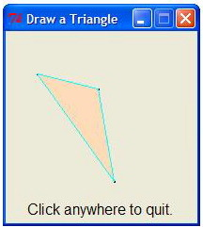
Getting Mouse Clicks

Slide 48
Getting Mouse Clicks
Notes:
If you are programming in a windows environment, using the .pyw extension on your file will cause the Python shell window to not display when you double-click the program icon.
There is no triangle class. Rather, we use the general Polygon class, which takes any number of points and connects them into a closed shape.

Slide 49
Getting Mouse Clicks
Once you have three points, creating a triangle polygon is easy: triangle = Polygon(p1, p2, p3)
A single text object is created and drawn near the beginning of the program. message = Text(Point(5,0.5), "Click on three points") message.draw(win)
To change the prompt, just change the text to be displayed. message.setText("Click anywhere to quit.")

Slide 50
Handling Textual Input
The triangle program’s input was done completely through mouse clicks.
The GraphWin object provides a getKey() method that works like the getMouse method.

Slide 51
Handling Textual Input
# clickntype.py
from graphics import *
def main():
win = GraphWin("Click and Type", 400, 400)
for i in range(10):
pt = win.getMouse()
key = win.getKey()
label = Text(pt, key)
label.draw(win)

Slide 52
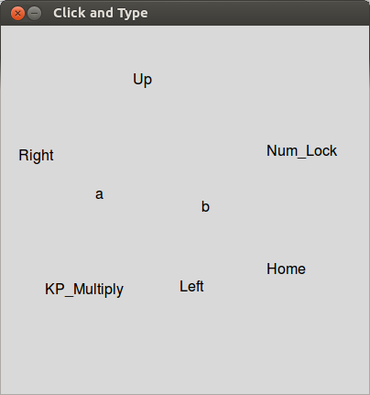
Handling Textual Input

Slide 53
Handling Textual Input
In addition to getting a single character, there’s also an Entry object that can get keyboard input.
The Entry object draws a box on the screen that can contain text. It understands setText and getText, like the Text object with one difference -- that the input can be edited by the user.

Slide 54
Handling Textual Input

Slide 55
Handling Textual Input
# convert_gui.pyw
# Program to convert Celsius to Fahrenheit using a simple
# graphical interface.
from graphics import *
def main():
win = GraphWin("Celsius Converter", 300, 200)
win.setCoords(0.0, 0.0, 3.0, 4.0)
# Draw the interface
Text(Point(1,3), " Celsius Temperature:").draw(win)
Text(Point(1,1), "Fahrenheit Temperature:").draw(win)
inputText = Entry(Point(2,3), 5)
inputText.setText("0.0")
inputText.draw(win)
outputText = Text(Point(2,1),"")
outputText.draw(win)
button = Text(Point(1.5,2.0),"Convert It")
button.draw(win)
Rectangle(Point(1,1.5), Point(2,2.5)).draw(win)

Slide 56
Handling Textual Input
# wait for a mouse click
win.getMouse()
# convert input
celsius = float(input.getText())
fahrenheit = 9.0/5.0 * celsius + 32
# display output and change button
outputText.setText(round(Fahrenheit,2))
button.setText("Quit")
# wait for click and then quit
win.getMouse()
win.close()
main()

Slide 57
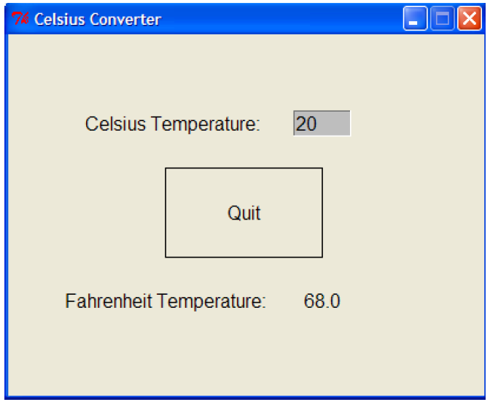
Handling Textual Input

Slide 58
Handling Textual Input
When run, this program produces a window with an entry box for typing in the Celsius temperature and a button to “do” the conversion.
The button is for show only! We are just waiting for a mouse click anywhere in the window.

Slide 59
Handling Textual Input
Initially, the input entry box is set to contain “0.0”.
The user can delete this value and type in another value.
The program pauses until the user clicks the mouse – we don’t care where so we don’t store the point!

Slide 60
Handling Textual Input
The input is processed in three steps:
The value entered is converted into a number with float.
This number is converted to degrees Fahrenheit.
This number is then converted to a string and formatted for display in the outputText text area.

